Slide 2
Engaging YMSM and YTGW in HIV Prevention
Wipaporn Natalie Songtaweesin, MBBS
Center of Excellence for Pediatric Infectious Diseases and Vaccines, Chulalongkorn University
Thai Red Cross AIDS Research Center
Notes:
While young people’s uptake of HIV testing and prevention programmes remains low, young people from key populations (men who have sex with men, sex workers, transgender people, people who inject drugs) face additional barriers. Due to stigma and lack of youth-friendly services, reaching them with HIV prevention and testing services is a pervasive challenge. To prevent new HIV infections and increase the number of these young people who know their status, innovative approaches, including social media and mobile apps, are being utilized to scale up access to HIV prevention and PrEP and increase testing rates. The objective of the session is to share best-practice examples of young key population-friendly prevention and testing programmes, sensitize service providers to young key population’s specific needs, and discuss ways to foster their engagement in research and programming.
10 minutes
Buenos Tardes, thank you for having me at this session, I will be speaking about engaging young msm and young tgw in HIV prevention services.

Slide 3
Conflicts of Interest
None to Disclose

Slide 4
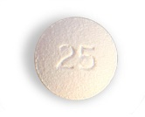
Overview – Engagement of Adolescents in HIV Prevention
Definitions, rationale
What we know
Examples of implementation of engagement
Practical take home thoughts
Notes:
Today I would like to talk about just 4 things with you. What we mean by engagement and why this is important, what we know about it so far, show you some examples of how engagement can be implemented, and hopefully by the end you will have some practical take home thoughts to apply to your own local settings.

Slide 5
What do we mean by ‘engagement’?
Maintaining all recommended aspects of care per CDC guidance for the duration of the study period
Diagnosis (Testing)
Linkage to care
ART(PrEP) initiation
ART (PrEP) adherence (+persistence)
Genberg, AIDS Behav, 2016
Coy, JIAS, 2019
Notes:
So what do we actually mean by engagement? It actually involves the entire process of care we provide to clients, from testing to linkage and care initiation as well as adherence to care. In recent years the term persistence is now being used more to address the importance of maintenance in care over time in addition to short-term adherence.

Slide 6
Notes:
If you work with adolescents you will know that it can sometimes be a challenge for several reasons, and at the same time, it can also be a daunting task for adolescents to access health services when they are in need. In this picture is a Thai young man living with HIV who was sexually and physically abused as a child so was forced to run away from home. He ended up doing sex work to survive and only came for HIV testing when a customer told him how ill he looked and advised him to get tested. It is at-risk adolescents like this that we feel have so much need for HIV prevention services and whose need form the basis of the need our services try to fulfil.

Slide 7
Retention and Adherence in Adolescent PrEP Studies
 | ATN 113¹ | ATN 110²
Population | YMSM (N=78) Aged 15-17yrs | YMSM (N=200) Aged 18-22yrs
Design | Open Label Demonstration Projects
Retention | 64% | 71%
Adherence at week 48 TFV-DP levels >700fmol/punch (>4 tablets PrEP/week) | 22% Adherence reduced with follow-up frequency | 34% Adherence reduced with follow-up frequency
Adherence at week 48 TFV-DP levels >350fmol/punch (2-3 tablets PrEP/week) | 28% | 50%
Lessons learned | Adherence better with monthly follow-up
Further study needs | Developmentally appropriate visit schedules Adolescent-friendly clinics | Racial disparities – culturally competent interventions
¹Hosek, JIADS, 2017
²Hosek, JAMA Pediatr, 2017
Notes:
---LITERATURE REVIEW---
So what do we know about retention and adherence of adolescents so far?
The largest adolescent studies done so far have been in young MSM and much less is known the situation with young TGW.
The adolescent trials network trials 113 and 110 looked at YMSM between 15-22 years of age and were open label PrEP demonstration projects that found overall retention to be only 60-70% with even lower adherence levels measured using tenofovir diphosphate levels of >700fmol/punch or the equivalent of at least 4 tablets of PrEP taken per week which we know confers an over 96% protective level against HIV at only 20-30%.
The key lessons learned from these studies were that adherence is better with monthly followup and as soon as followup intervals increased to 12 weeks, adherence levels dropped markedly.
The studies also highlighted the importance of providing developmentally appropriate visit schedules and adolescent friendly clinics, in addition to being culturally sensitive to client needs.

Slide 8
PrEP Engagement in YMSM+YTGW
Individual
Higher PrEP stigma – lower PrEP use
Mustanski, CROI 2019
Younger age associated with discontinuations (median age 24yrs)
Serota, CROI 2019
Service Delivery
High acceptability of electronically delivered PrEP
Siegler, CROI 2019
Interventions supporting PrEP persistence needed
On-demand PrEP for periods of less sexual activity
Serota, CROI 2019
Notes:
Regarding engagement of adolescents in PrEP services, at the individual level, it has been found that higher PrEP stigma is associated with lower PrEP use and that it is the younger age groups that tend to discontinue PrEP more. At the service delivery level adolescents are highly accepting of service delivery electronically, and that there remain substantial challenges in delivering interventions that support PrEP persistence over time and one of the ways this could be done is through providing on-demand PrEP for periods where adolescents had less sexual activity.
Siegler et al
Abstract 955
Telehealth Medicine
Young Black MSM
Age 18-30 years
N=50
High acceptability of electronically delivered PrEP service (93%)
[Multi-site in the US]
http://www.croiconference.org/sites/default/files/posters-2019/1430_Siegler_0955.pdf
‘ePrEP, a smartphone telemedicine system with video consultations, lab testing using home specimen collection, and when possible home prescription delivery’
Mustanski et al
Abstract 988
HIV Stigma Reduction
YMSM + YTGW
Age 16-29 years
N=105
Positive attitudes to PrEP - higher PrEP use (OR, 5.05)
Higher stigma – lower PrEP use (OR, 0.50)
[Chicago]
http://www.croiconference.org/sites/default/files/posters-2019/1430_Mustanski_0988.pdf
Serota et al
Abstract 963
PrEP Persistence and Discontinuations
Young Black MSM
Age 18-29years
N=125 (initiated PrEP)
Younger age associated with discontinuations
Need for interventions to support PrEP persistence
Evaluation of on-demand PrEP for periods of less sexual activity
[Atlanta]
http://www.croiconference.org/sites/default/files/posters-2019/1430_Serota_0963.pdf

Slide 9
Very high HIV prevalence and incidence, but low testing uptake, among young Thai MSM 2016-2018
MSM – men who have sex with men
MSW – male sex workers
Source: USAID LINKAGES program data, 2016-2018.
Slide Courtesy of Dr Nittaya Phanuphak
Notes:
--OUR CONTEXT—
Next 4 slides data from LINKAGES Thailand. Program data (not research data) from 2016-2018. There are 10 CBOs in 6 provinces who contributed to these data.
Key Point: BARS SHOW TESTING AND LINES SHOW YIELD – LOW TESTING BUT HIGH INCIDENCE, ONLY 11% OF ALL TESTED WHEN MUCH HIGHER INCIDENCE OF 10.21 PER 100 PY COMPARED TO ADULT FIGURS OF 6.19
So what is going on in Thailand at the moment? The data we have in YMSM at the moment is that despite high incidence levels depicted as the lines in this graph compared to older age groups, testing levels remain low with only 11% of all being tested being adolescents, despite the overall extremely high incidence of 10 per 100 person years in this population.

Slide 10
Very high HIV prevalence and incidence, but low testing uptake, among young Thai TGW 2016-2018
MSM – men who have sex with men
MSW – male sex workers
Source: USAID LINKAGES program data, 2016-2018.
Slide Courtesy of Dr Nittaya Phanuphak
Notes:
--OUR CONTEXT-
KEY POINT: BARS TESTING – LOW BUT LINES V HIGH YIELD, AGAIN, LOW PROPORTION OF ALL TESTED BUT HIGHER INCIDENCE THAN OTHER AGE GROUPS
Unfortunately, this situation is similar with Young transgender women with low testing rates despite high incidences of HIV, particularly in sex workers

Slide 11
Low access to PrEP services among young MSM and TGW in Thailand, January 2016 – June 2019
Source: USAID LINKAGES Princess PrEP program data, January 2016 – June 2019.
Slide Courtesy of Dr Nittaya Phanuphak
Notes:
--OUR CONTEXT—
ADOLESCENTS <20YRS MAKING UP A VERY SMALL PERCENTAGE OF ALL TESTED
And when we look at those who access PrEPservices, adolescents made up only 7% of all MSM and 9% of all TGW coming forward to receive PrEP.

Slide 12
Retention in PrEP program among MSM and TGW in Thailand, by age 2016-2018
YMSM
YTGW
Slide Courtesy of Dr Nittaya Phanuphak
Notes:
--OUR CONTEXT-
OREINTATE – PREP RETENTION IN THAI PREP PROGRAMS - LEFT SIDE MSM RETENTION, RIGHT TGW , AGE <20 ON LEFT RETENTION LOWEST IN UNDER 20S
Even when adolescents do access PrEP, they fare much worse in terms of retention as you can see for both Thai MSM and TGW.

Slide 13
Engaging Adolescents
Utilize Peers
Holistic Care
Make Services Fun
Utilize Technology
Freese TE, AIDS Patient Care STDS, 2017
Notes:
So what can we actually do about these challenges?
In 2015, a National YMSM+LGBT Provider Summit in California came together to look at how adolescents can be more effectively engaged in services and found that there were four key areas in which adolescent engagement could be improved.
Utilize Peers – Tailoring of services to KP needs
Holistic Care - addressing the person rather than just the risk because it is the person that will manage the risk. School, boyfriends, money, family stresses, how are they managing all this?
Make Services Fun – they are all about fun and esp in prevention have more fun places to be– we have had TGW clients ask us to set up a hair and nail salon there if we wanted her there more willingly
Utilize Technology – they have grown up with technology and are comfortable around it
A key step in the HIV care cascade is engagement for HIV testing and prevention or treatment
Conclusion from a National YMSM+LGBT Provider Summit in California 2015
[The Substance Abuse and Mental Health Services Administration-funded Center of Excellence on Racial and Ethnic Minority Young Men Who Have Sex with Men and Other Lesbian, Gay, Bisexual, and Transgender Populations (YMSM + LGBT CoE) NationalYMSMProvider Summit in Hollywood, California]

Slide 14
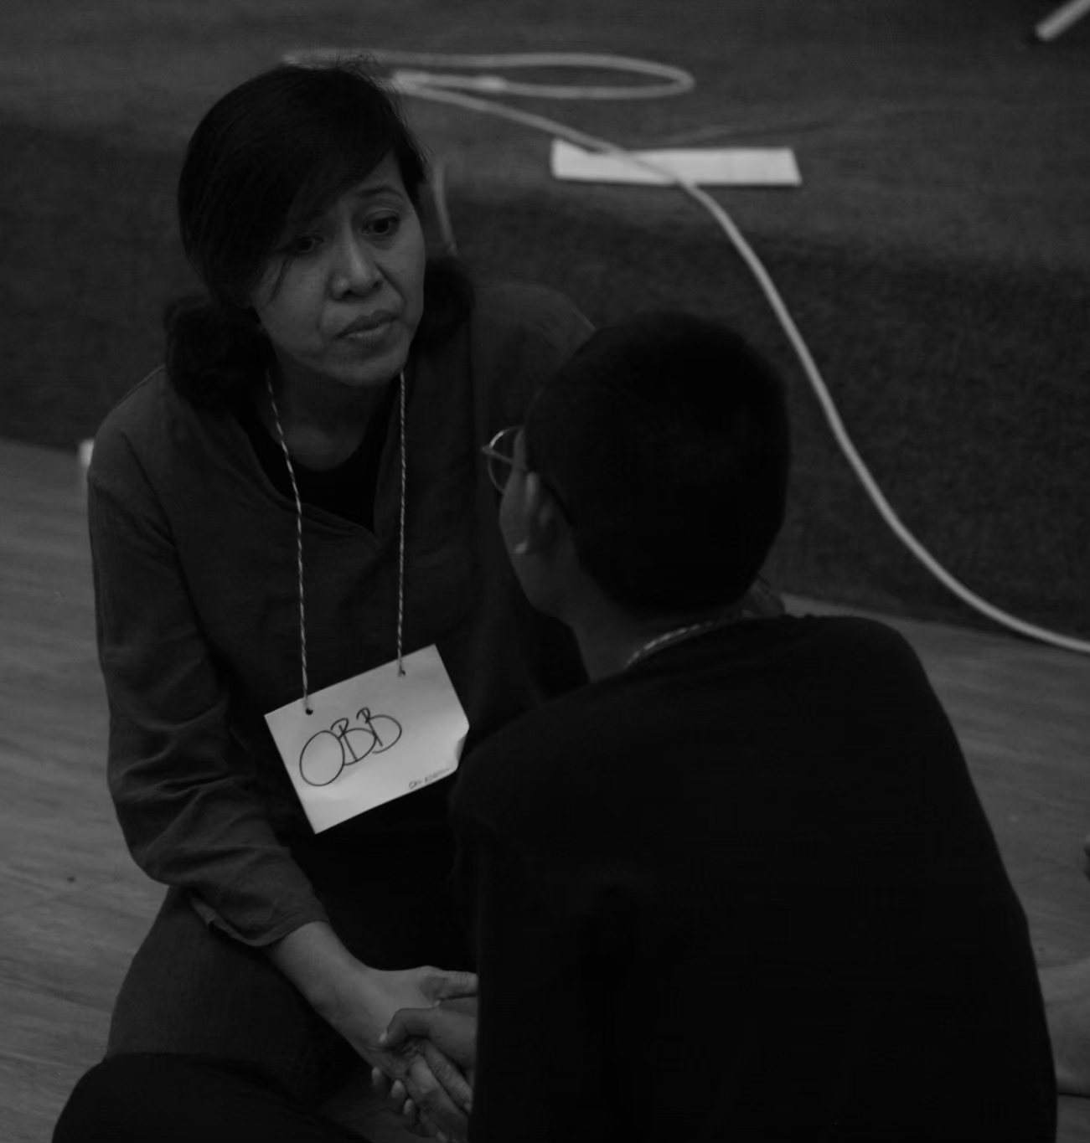
Building Resilience
Engaging in Health Promoting Cognitive Processes
Enacting Healthy Behavioural Practices
Enlisting Social Support from Others
Empowering Other Young/Gay Bisexual Men
Harper GW, AIDS Patient Care STDS, 2014
Notes:
Another fantastic study by Harper and colleagues in 2014 looked at how young gay and bisexual men diagnosed with HIV were able to develop resilience to their situation and identified these four topics which I think is extremely helpful to consider in developing HIV prevention delivery services to adolescents. It included engaging them in promoting cognitive processes, such as reevaulating their life goals, gaining a sense of control through seeking knowledge, and enacting healthy behavioural practices such as increasing exercising, healthy eating and cutting down on smoking and having safer sex, enlisting the social support of others and also empowering them to take control of their own lives through developing positive self images and using their experience to help others in a similar situation to them.
Qualitative study by Dr Harper and colleagues in 2014 in young gay/bisexual men diagnosed with HIV to understand resilience processes
Culturally Appropriate
Strengths Based

Slide 15
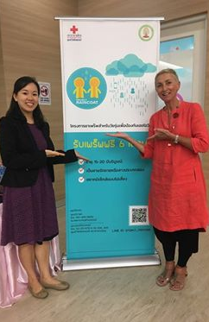
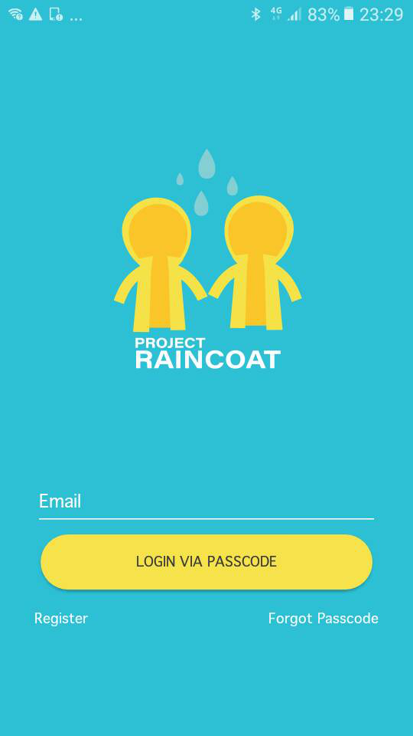
Project Raincoat
200 MSM, TGW
15-19 yrs
Combination Package Care
Community-Based Key Population- Led Care
Notes:
---OUR PROJECT---
These concepts form the basis of Project Raincoat for which we are extremely grateful towards CIPHER and the IAS who funded us to do this project where we enrolled 200 MSM and TGW aged 15-19. We provided them with a combination care package which included free PrEP, condoms and lubricants, a mobile phone app supporting PrEP adherence, online counsellor access, youth-friendly nonjudgemental counsellors, support for mental health, substance misuse issues, screening for and diagnosis of STIs and community based key population led care.

Slide 16
Adolescent PrEP Retention
N=142
N=51
N=125
N=21
N=93
N=14
N=61
N=9
Notes:
---OUR PROJECT---
Although this study is still ongoing what we have found so far has been encouraging with 82-98% retention rates seen so far in the 6 months of the follow-up period of this project.

Slide 17
Commonly faced issues – Project Raincoat
“I had no idea there was such a thing as PrEP”
“I’m the eldest son and my parents would be so disappointed if they found out I was gay”
Lack of knowledge
“I can’t come in to get an HIV test – I have class”
Gender Stigma
Structural Barriers
“I was scared to get an HIV test”
“No test result means no infection”
HIV Stigma
Fear
Notes:
The issues we have found adolescents have faced in our project have been wide ranging and we have learned a lot in trying to understand and support our adolescents through their personal challenges.
--WHAT WE WANT TO SHARE—
Hosek S, Celum C, Wilson CM, Kapogiannis B, Delany-Moretlwe S, Bekker LG. Preventing HIV among adolescents with oral PrEP: observations and challenges in the United States and South Africa. J Int AIDS Soc. 2016;19(7(Suppl 6)):21107.
Hosek SG, Landovitz RJ, Kapogiannis B, Siberry GK, Rudy B, Rutledge B, et al. Safety and Feasibility of Antiretroviral Preexposure Prophylaxis for Adolescent Men Who Have Sex With Men Aged 15 to 17 Years in the United States. JAMA pediatrics. 2017;171(11):1063-71.1.
Bekker LG, Johnson L, Wallace M, Hosek S. Building our youth for the future. J Int AIDS Soc. 2015;18(2 Suppl 1):20027.

Slide 18
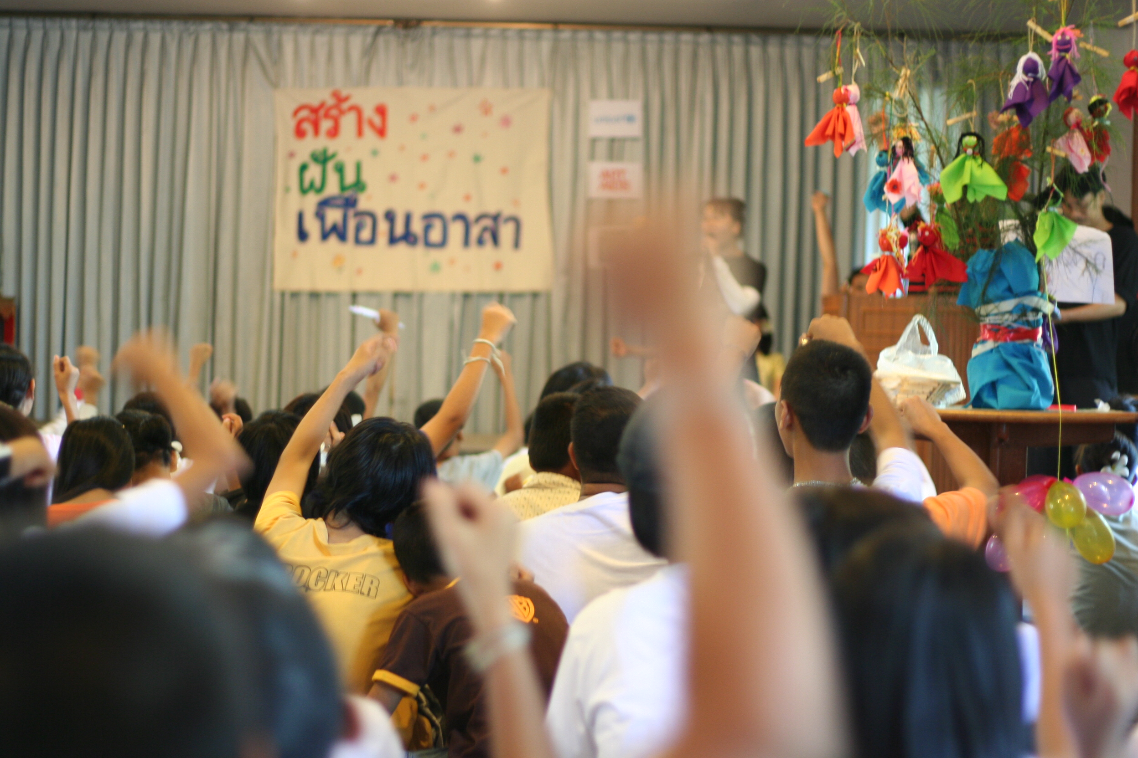
Lessons Learned – Project Raincoat
Peer volunteers making dreams a reality together
Individual
Mutual Respect
Promotion of Internal and External Resilience
Support for thinking process
Positive Reinforcement
Social
Peer Support
Camps
Structural
Flexible hours
Short waiting times
Friendly staff
Technology
Notes:
We have learned a lot from our adolescents which I think can be divided into individual, social and structural lessons which have included their need to be treated with respect, the importance of supporting their resilience through life challenges and supporting their thinking processes rather than just telling them what to do, and always focusing on the positive rather than the negative. Socially we have learned adolescents are greatly supported and encouraged through peer supporters and making connections with other peers with similar issues at camps. Structurally they have taught us that flexible hours, short waiting times, friendly tasks and providing online care has been key their satisfaction of our services.

Slide 19
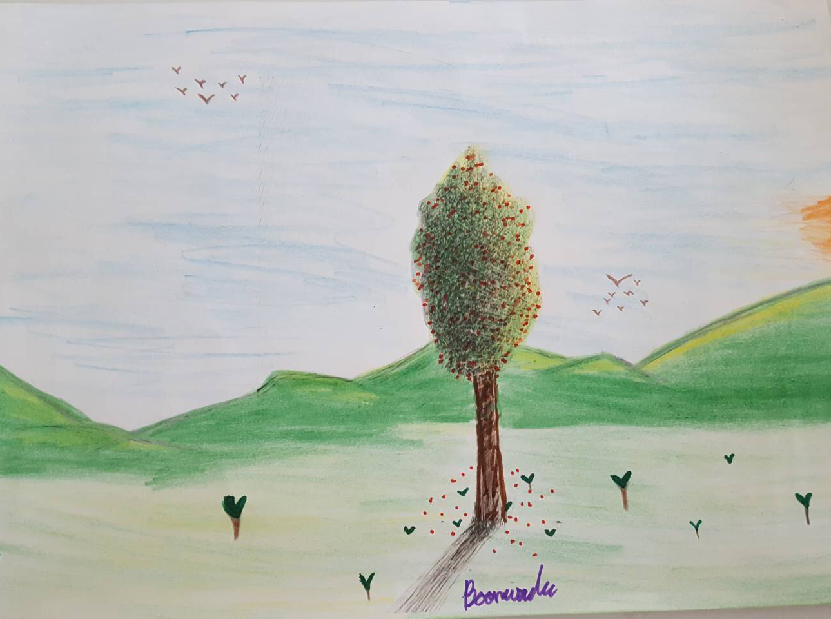
Looking Forward
Utilizing mHealth
Accessibility
Social support
Reduction of stigma
Informed Choices
Empowerment
Notes:
I think a lot still has to be done in our efforts to retain adolescents in care. Using mobile phones I feel will help hugely in allowing services to become accessible.

Slide 20
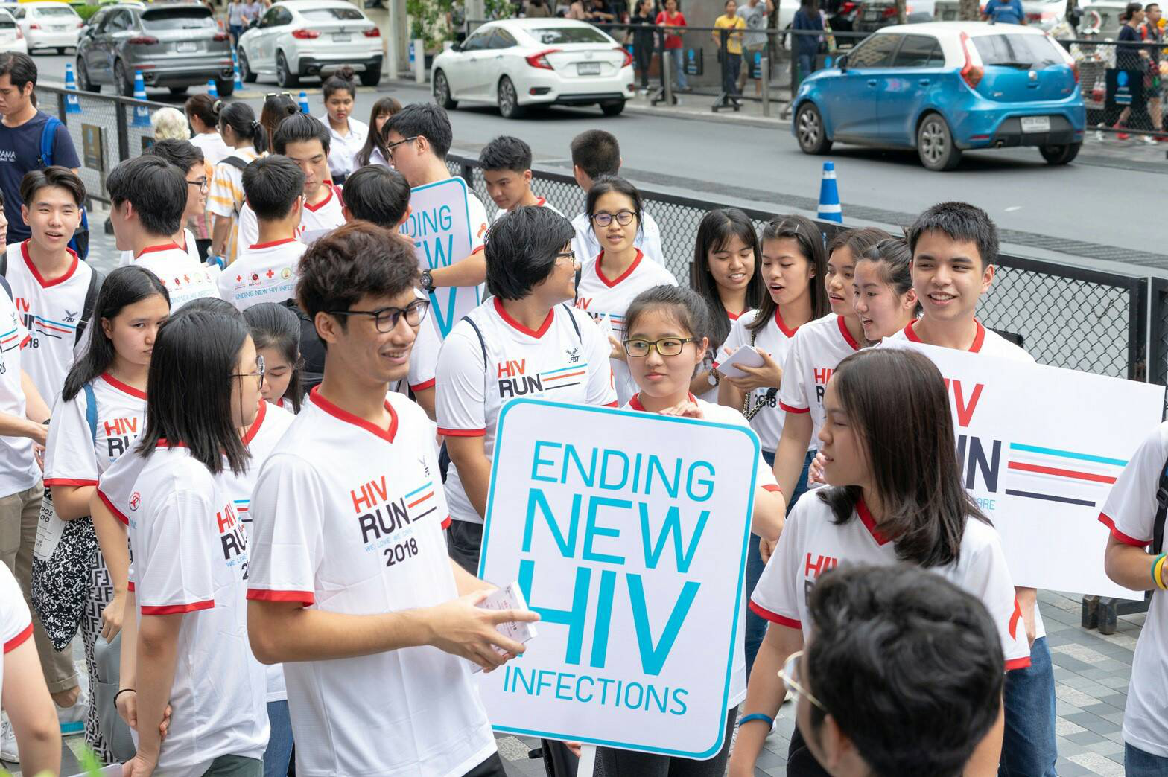
Engaging and Retaining Adolescents - Take Home Messages -
Make it a positive experience!
Utilize peers, holistic care, make services fun, utilize technology
Dynamic Process
Get them safely to the other side!

Slide 21
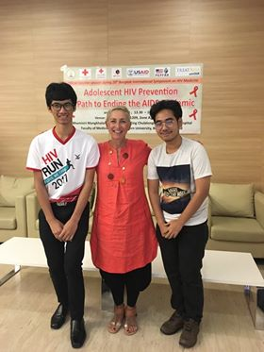

Slide 22
Acknowledgements
All adolescents and their families
Thai Red Cross AIDS Research Centre
Professor Praphan Phanuphak
Dr Nittaya Phanuphak
Somsong Teeratakulpisarn
Nuttawut Teachatanawat
Narukjaporn Thammajaruk
Center of Excellence for Pediatric Infectious Diseases and Vaccines
Assoc Prof Chitsanu Pancharoen
Assoc Prof Thanyawee Puthanakit
Tuangtip Teerawit
Prissana Wongharn
HIVNAT
Dr Stephen Kerr
Jiratchaya Sophonphan
Duke University
Dr Sara LeGrand
Shashika Bandara

Slide 23
Gracias

